Slide 1
Deep Learning
Object Detection-1 Session 6
Object detection is about classifying objects and defining a bounding box around them.
( content has been taken from various authors and websites)
Notes:
9/30/2018
1

Slide 2
Todays Agenda
Recap
Overview of Object Detection
Overview of the Algorithms used for Object Detection.
Sample Code
Questions.

Slide 3
Road Map
CNN Theory
Transfer Learning
Adversarial Examples
GANS
3 rd Party AI Interface (DeepCognitive.AI)
Object Detection – Session 1
Object Detection – Session 2
Object Detection with Transfer Learning ( using our datasets)
Porting Object Detection to Raspberry PI 3
Simple Robotics and AI

Slide 4
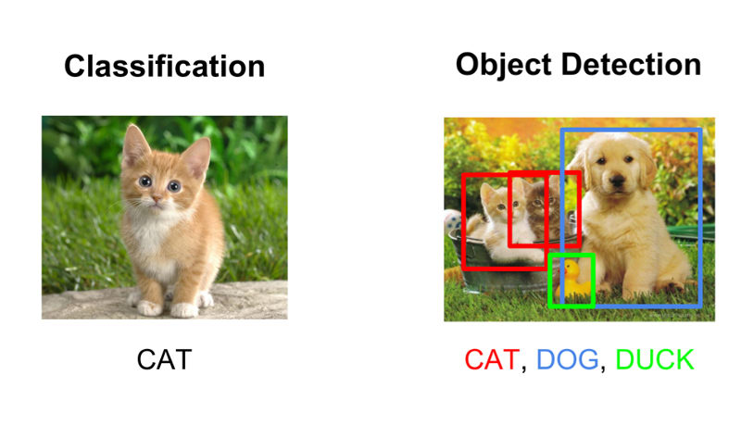
Difference Between Image Classification and Image Detection
Image Classification:
Identifies an image into a single class.
Image Detection:
Identify multiple objects in a single image.
Draw a bounding box around each detected object
Classifies the Image, and give a Probability or Confidence Score.

Slide 5
Why cant we use a standard CNN ?
Object detection is the problem of finding and classifying a variable number of objects on an image.
The important difference is the “variable” part. In contrast with problems like classification, the output of object detection is variable in length, since the number of objects detected may change from image to image.
1) The length of the output layer is variable — not constant.
2) The Identified objects may have different Spatial Ratio, locations and Orientations.
You would have to select a huge number of regions and this is computationally expensive.

Slide 6
General object detection framework
.
OBJECT LOCALIZATION: A model or algorithm is used to generate regions of interest or region proposals. These region proposals are a large set of bounding boxes spanning the full image .
OBJECT CLASSIFICATION: Visual features are extracted for each of the bounding boxes, they are evaluated and it is determined whether and which objects are present in the proposals based on visual features.
NON MAXIMUM SUPPRESSION: Overlapping boxes are combined into a single bounding box.

Slide 7
Confusion Matrix
https://acutecaretesting.org/en/articles/precision-recall-curves-what-are-they-and-how-are-they-used

Slide 8
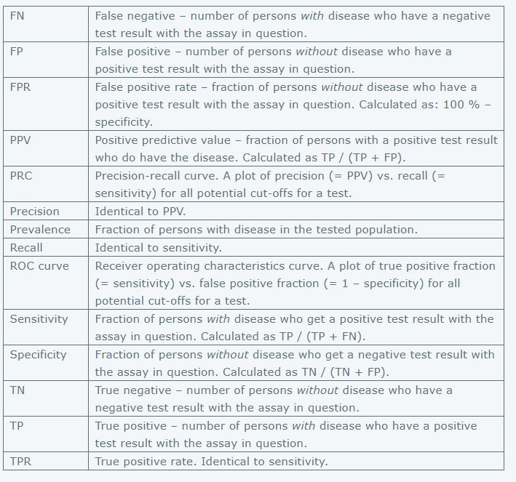

Slide 9
Evaluating Object Detectors
In object detection, there are two distinct tasks to measure:
Determining whether an object exists in the image (classification)
Determining the location of the object (localization, a regression task).
The most common evaluation metric that is used in object recognition tasks is:
‘mAP’, ‘mean average precision’.
It is a number from 0 to 100 and higher values are typically better.
Calculate the AP Average Precision for each class.
( area under the Precision –Recall Curve for that class)
Calculate the mAP by taking the average over the APs of all classes.
Link

Slide 10
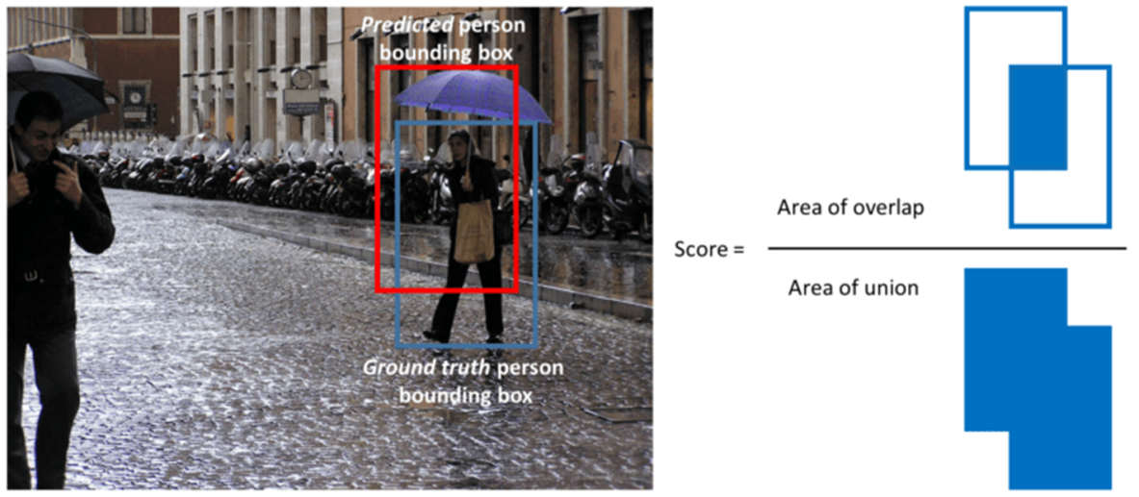
IoU (Jaccard Index)
Intersection over Union is a ratio between the intersection and the union of the predicted boxes and the ground truth boxes.
To Calculate IoU, we need
The ground-truth bounding boxes .
The predicted bounding boxes from our model.
IoU score > 0.5 is considered a “good” prediction.
Eg True Positive = IoU >0.5
False Positive = IoU<= 0.5

Slide 11
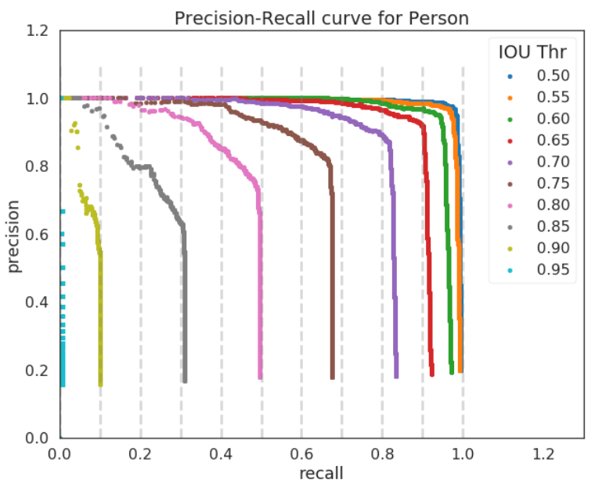
Precision-Recall Curve (sample)
Precision is the ability of a model to identify only the relevant objects
Recall is the ability of a model to find all the relevant cases (all ground truth bounding boxes)
Link

Slide 12
mAP = AVG(AP for each object class)
AP = AVG(Precision for each of 11 Recalls {precision = 0, 0.1, ..., 1})
PR-curve = Precision and Recall (for each Threshold that is in the Predictions bound-boxes)
Precision = TP / (TP + FP) :
What Proportion of Objects we predicted as cats were actually cats
Recall(Sensitivity) = TP / (TP + FN)
What Proportion of objects that were cats, were predicted as cats.
Where;
TP = number of detections with IoU>0.5
FP = number of detections with IoU<=0.5 or detected more than once
FN = number of objects that not detected or detected with IoU<=0.5

Slide 13
Types of Object Detector Algorithms
For Historical reasons .
Viola–Jones object detection framework (2001) by Viola and Jones
Histogram of oriented gradients (2005) by N. Dalal and B. Triggs
Current Object Detectors based on Convolution .
Region Based object detectors (R-CNN, Fast R-CNN, Faster R-CNN, R-FCN, FPN)
Single Shot object detectors (SSD, YOLOv3)

Slide 14
Sliding Window
A sliding window was used to look for objects at different locations and scales.
To detect an object in a image, we start by picking sliding window of size (x) and then feeding input region (x) to trained convnet by sliding window over every part of input image.
For each input region, convnet outputs whether it has a object or not.
We run sliding window multiple times over the image with different window size, from smaller to larger, hoping a window size would fit the object and allow convnet to detect it.
We have to crop so many regions and run convnet for each of them individually.
Computational cost is a huge disadvantage of sliding window algorithm.
Increasing window and stride size makes it faster but at cost of decreased accuracy.

Slide 15
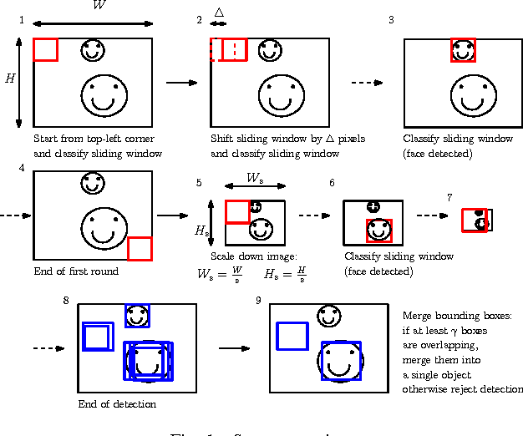
Sliding Window
RASW: A run-time adaptive sliding window to improve Viola-Jones object detection
Francesco Comaschi, Sander Stuijk,

Slide 16
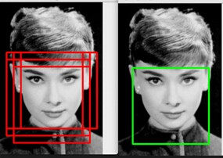
Non-maximum suppression
Non-maximum suppression is a post-processing algorithm responsible for merging all detections that belong to the same object
.

Slide 17
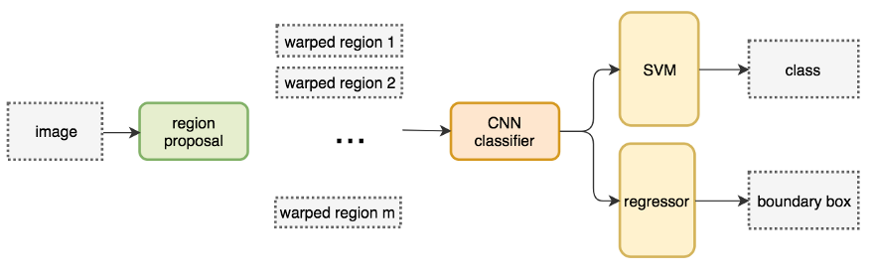
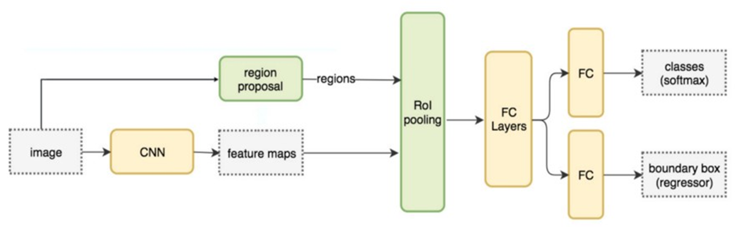
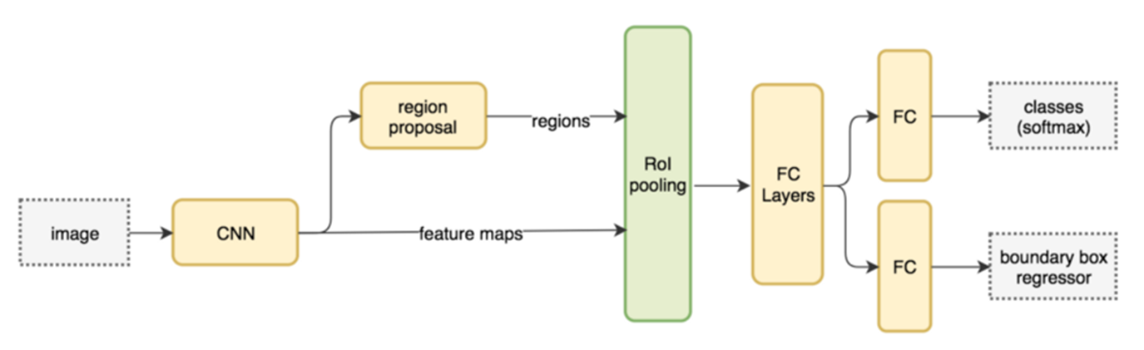
R-CNN
Fast R-CNN
Faster R-CNN

Slide 18
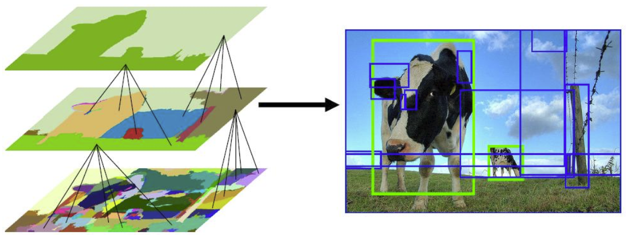
Selective Search
Selective Search is a region proposal algorithm used in object detection.
It is based on computing hierarchical grouping of similar regions based on color, texture, size and shape compatibility, an is designed to be fast with a very high recall
First, color similarities, texture similarities, region size, and region filling are used as non-object-based segmentation. Therefore we obtain many small segmented areas as shown at the bottom left of the image above.
Then, bottom-up approach is used that small segmented areas are merged together to form larger segmented areas.
Thus, about 2K region proposals (bounding box candidates) are generated as shown in the image.

Slide 19
R-CNN Region-based Convolutional Neural Network
Propose regions :Scan the input image for possible objects using Selective Search. (upto 2000 Region Proposals)
These proposals are then “warped” into an image size used by the CNN
Extract features: Run a CNN on each of these wraped region proposals.
Classify Regions Proposals: Take the output(Feature Vector) of each CNN and feed it into
an SVM (Support Vector Machine) to classify the region .
a linear regressor to tighten the bounding box of the object.
Non-maxima suppression is then used to suppress bounding boxes that have a significant overlap with each other.

Slide 20
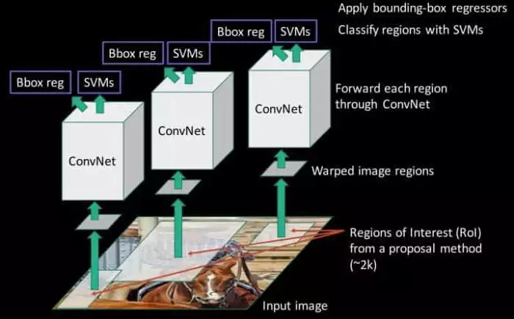
R-CNN Region-based Convolutional Neural Network

Slide 21
R-CNN System Flow

Slide 22
Fast R-CNN
Fast R-CNN improved on its detection speed through two main augmentations:
Performing feature extraction over the image before proposing regions, thus only running one CNN over the entire image instead of 2000 CNN’s over 2000 overlapping regions.
Replacing the SVM with a softmax layer.
Fast R-CNN uses fully connected layers, we apply ROI pooling to warp the variable size ROIs into in a predefined size shape.
We have one neural net to train, as opposed to one neural net and many SVM’s.
Fast R-CNN performed much better in terms of speed. There was just one big bottleneck remaining: the selective search algorithm for generating region proposals.

Slide 24

FAST R-CNN

Slide 25
Faster R-CNN
Faster R-CNN replaced the slow selective search algorithm with a fast neural net. Region proposal network (RPN).
At the last layer of an initial CNN, a 3x3 sliding window moves across the feature map and maps it to a lower dimension (e.g. 256-d)
For each sliding-window location, it generates multiple possible regions based on k fixed-ratio anchor boxes (default bounding boxes)
Each region proposal consists of
an “objectness” score for that region
4 coordinates representing the bounding box of the region
In other words, we look at each location in our last feature map and consider k different boxes centered around it: a tall box, a wide box, a large box, etc.
For each of those boxes, we output whether or not we think it contains an object, and what the coordinates for that box are. This is what it looks like at one sliding window location:

Slide 26
Faster R-CNN
The 2k scores represent the softmax probability of each of the k bounding boxes being on “object.”
The RPN outputs bounding box coordinates, it does not try to classify any potential objects: its sole job is still proposing object regions.
If an anchor box has an “objectness” score above a certain threshold, that box’s coordinates get passed forward as a region proposal.
Once we have our region proposals, we feed them straight into what is essentially a Fast R-CNN.
We add a pooling layer, some fully-connected layers, and finally a softmax classification layer and bounding box regressor.
In a sense, Faster R-CNN = RPN + Fast R-CNN.

Slide 27

FASTER R-CNN

Slide 28
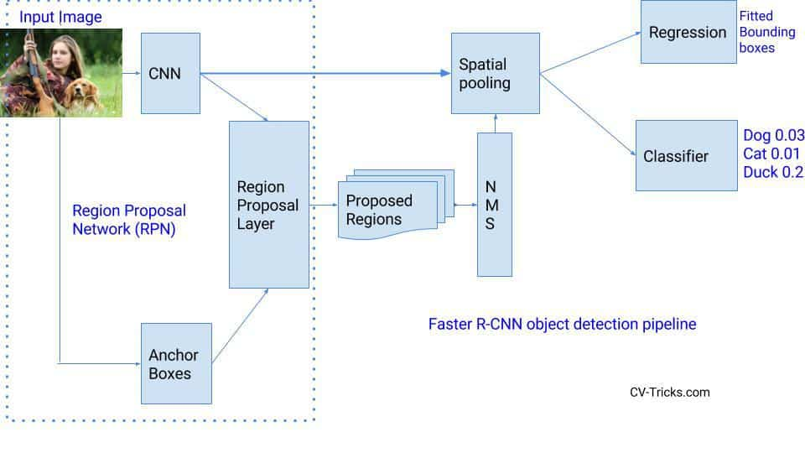
FASTER R-CNN

Slide 29
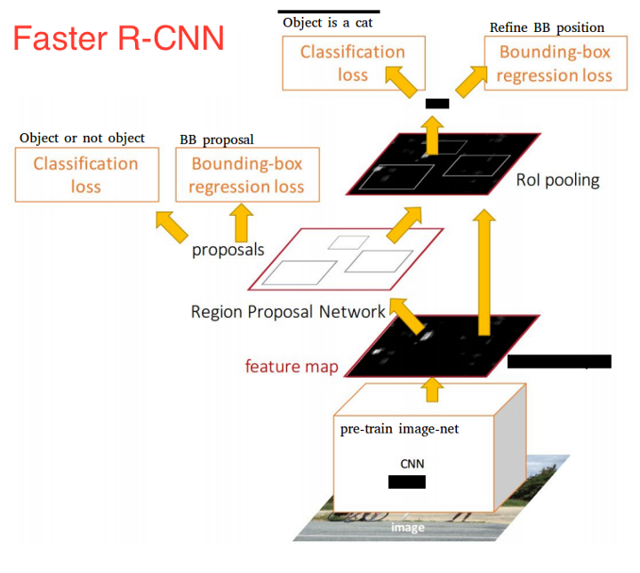

Slide 30
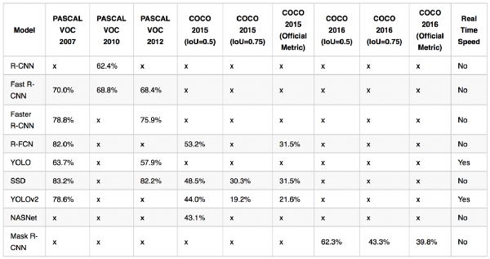
Object Detection Algorithms Comparison

Slide 31
NEXT Session
SSD (Single Shot Detectors)
YOLO
Sample code

Slide 32
Contact Details
Email: aliasgertalib@gmail.com
Linkedin: https://www.linkedin.com/in/aliasgertalib
GitHub
https://github.com/aliasgertalib-AI

Slide 33
References
R-CNN model (R. Girshick et al., 2014)
FAST R-CNN R. Girshick (2015)
FASTER R-CNN S. Ren and al. (2016)
R-FCN J. Dai and al. (2016)
YOLO (J. Redmon et al., 2016)
SSD W. Liu et al. (2016)
YOLO9000 J. Redmon and A. Farhadi (2016) (https://pjreddie.com/darknet/yolo/)
NASNet (B. Zoph and Q.V. Le, 2017)
Mask R-CNN K. He and al. (2017)
Jaccards Index
Model Comparisons
Model Comparisons
TimeLine
Object Detection Techniques
https://towardsdatascience.com/deep-learning-for-object-detection-a-comprehensive-review-73930816d8d9
https://medium.com/@timothycarlen/understanding-the-map-evaluation-metric-for-object-detection-a07fe6962cf3
https://deepsense.ai/region-of-interest-pooling-explained/
what-do-we-learn-from-region-based-object-detectors-faster-r-cnn-r-fcn-fpn
faster-r-cnn-explained
what-do-we-learn-from-single-shot-object-detectors-ssd-yolo-fpn-focal-loss
http://www.robots.ox.ac.uk/~tvg/publications/talks/fast-rcnn-slides.pdf
http://www.telesens.co/2018/03/11/object-detection-and-classification-using-r-cnns/
https://tryolabs.com/blog/2018/01/18/faster-r-cnn-down-the-rabbit-hole-of-modern-object-detection/
fasterrcnn-explained-part-1-with-code

